Slide 1
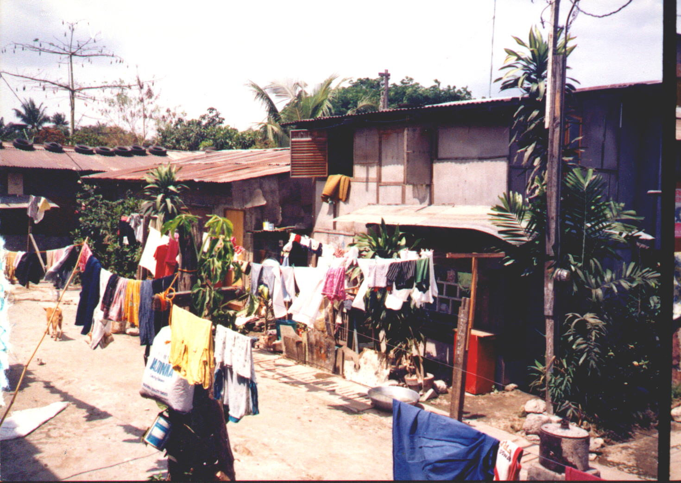
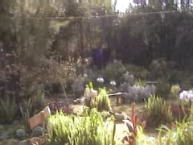

Cash Flows in a Holistic Urban Poor Church Plant
©Viv Grigg, July 2003

Slide 2
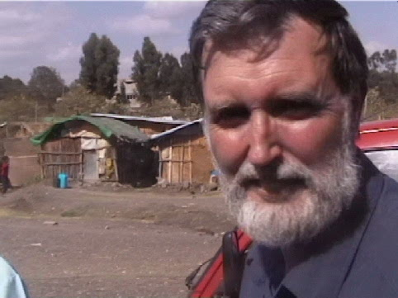
1. Progressions in a Holistic Urban Poor Church Plant
Internal Slum Church Dynamics
Churchplanting Team
Church building
Land
Church
Incarnation
Eldership
Discipleship
Leadership
Land Rights
House for Pastor
Deacons skilled in admin
Community
Community Development
Time frames
Yrs ------------------------- 1 -----------------------------2 -----------------3--------------4-----------5---------6-------

Slide 3
2. Entrance, Proclamation, Discipleship
1. The early phase of capitalisation of the
churchplanting team is needed for sufficient time to establish the congregation (1-3 years). This requires resources.
Internal Slum Church Dynamics
Churchplanting Team
Creation of People
Resources
and Tithes
2. If trained to tithe from before entrance to the Kingdom, the growth of the congregation results in resources. In a slum community this is usually up to 50-80, not enough to fund the pastor, nor a church building, nor community development.
Evangelism
creates resources of
people and tithes from
within the community
Church
Discipleship
3. When up to 300-600 are discipled (5 years?) this may be sufficient to support the cost, in order of priority, of
Renting
Pastor’s salary
Running the ministry
Some physical needs of the community of faith.
External Resources
1. Self-Employment (all Latin slum pastors support themselves)
2. Capital from Denomination (often Western funding)
3. Capital from Businessmen in the City

Slide 4
3. Land for Stable Worship
Without it Slum Churches Disappear
4. The critical issue for sustainability is buying of land for a church of 120 or so. House churches are not sustainable as a model. There is too much social pressure.
House churches do not provide a basis for holistic community development
Once a church has capitalised the land and some initial construction, it will build its own structures, and can use former rent for paying off the rest of the construction loan, payment of pastor and ministry costs.
Even though this slum land is not formally owned there are rules within the slums themselves as to who are owners, which allow seim-formal purchases, and often there is land just outside.
One way of doing this is developing a preschool and primary school. Another is through developing a community centre.
Churchplanting Team
Rent
Land
House Churches
Church
There is a common fallacy that because evangelism can occur
rapidly then the churches have been planted.
Funding for an educational
centre

Slide 5
4. From Church to Community Transformation
5. To bring the church to self-sufficiency,
at least the leaders of the church need to be able
to support their families.
Community
6. This requires input
in terms of microenterprise through credit
cooperatives, in a self-regeneating way. Most
micro-finance organisations will not
work through churches.
Church
Creation of People Resources
and tithes
Discipleship
Eldership
Leadership
Deacons skilled in service & admin
7. Once the church is established there is a people
resource base. Development of holistic churches
where the Kingdom impacts every aspect of
the community requires further capital for
projects.
House for Pastor
Community Development
External Resources
Foreign Funding
now can contribute
to ongoing community
development growth
based on existent
people and community
resources
Skills Development, microfinance
capital for church members

Slide 6
5. Example from Nairobi, Kenya
Cash Flows in an Urban Poor Church Plant
Land Rent is $5/mo. Buy $2,000 for 10x15 ft
expanding at $1000/new room per year
Churchplanting Team
With land, people build their own building
according to local design
Tithes up to $15-20 per month
for congregation of 100
Church building
Church
Evangelism
creates resources of
people and tithes from
within the community $5-10 /mo
for whole congregation of 50
Leadership
Community Development
External Resources
Foreign Funding
now can contribute
to ongoing growth
based on existent
people and community
resources
Self-Employment (60% are un- or underemployed - not a viable option)
Capital from
Businessmen
in the City -
untapped
Capital from
Denomination
US$65/mo
Skills Development through micro-
finance capital for church members
$100 per initial loans

Slide 7
6. Example from Mumbai, India
Cash Flows in an Urban Poor Church Plant
Land Rent is $20/mo. Buy $2,000 for 10x15 ft
expanding at $1000/new room per year in new slum.
Buy in older slum for $20,000, plus $20,000 Construction costs
Churchplanting Team
With land, people build their own building
according to local design
Tithes up to $15-20 per month
for congregation of 100
Church building
Church
Evangelism
creates resources of
people and tithes from
within the community $5-10 /mo
for whole congregation of 50
Leadership
Community Development
External Resources
Foreign Funding
now can contribute
to ongoing growth
based on existent
people and community
resources
Self-Employment (28% are un- or underemployed - a viable option)
Capital from
Businessmen
in the City -
increasing
Skills Development through micro-
finance capital for church members
$100 per initial loans
Capital from
Denomination
US$100/mo (Salary)

Slide 8
7. Example from Manila
Cash Flows in an Urban Poor Church Plant (US$=P54)
Land & Building Rent is P4000/mo. Buy P200,000 for 20x20 ft
expanding at P___/new room per year in new slum.
Buy in older slum for P200,000, plus P200,000 Construction costs
Churchplanting Team
With land, people build their own building
according to local design
Tithes up to P3000-5000 per month
for congregation of 100
Church building
Church
Evangelism
creates resources of
people and tithes from
within the community P1500-2000 /mo
for whole congregation of 50
Leadership
Cost of Pastor’s salary
Free to P7,500, wife working
Community Development
External Resources
Foreign Funding
now can contribute
to ongoing growth
based on existent
people and community
resources
Self-Employment (28% are un- or underemployed - a viable option)
Capital from
Businessmen
in the City -
increasing
Skills Development through micro-
finance capital for church members
P5000 – P8000 per initial loan.
Capital from
Denomination
US$100/mo (Salary)

Slide 9
8. Time Frames and Cash Flows
Inappropriate
funding (excessive or at wrong times) destroys
the human resource
development. Funding for land (usually attached as an admin cost to a community project or as part of establishing a school) speeds the process dramatically
Leadership does not occur rapidly
Creation of People
Resources
and Tithes
Land
Church building
Church
Leadership
Community
Time frames for funding resources
Yrs ------------------------- 1 -----------------------------2 -----------------3--------------4-----------5---------6-------
External Resources
Foreign Funding
now can contribute
to ongoing growth
based on existent
people and community
resources
Self-Employment
Education funding
Capital from
Businessmen
in the City
Capital from
Denomination
Skills Development through micro-
finance capital for church members

